Slide 1
Ensemble Method as a Defense Against Adversarial Examples

Slide 2
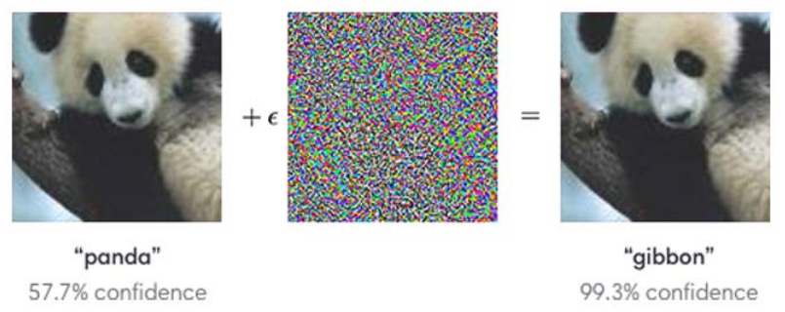
Introduction
Power of deep learning algorithms
Examples: Autonomous vehicles, image classification, security
Deep neural networks are vulnerable to small perturbations to images, resulting in a significant decrease in performance.
Notes:
Modern Deep Learning practices can be easily tricked by generating adversarial examples.
Adversarial Examples are inputs to machine learning models that an attacker has intentionally designed to cause models to fail or misclassify
Adversarial examples can be small perturbations to training images that are not detectable to the human eye.

Slide 3
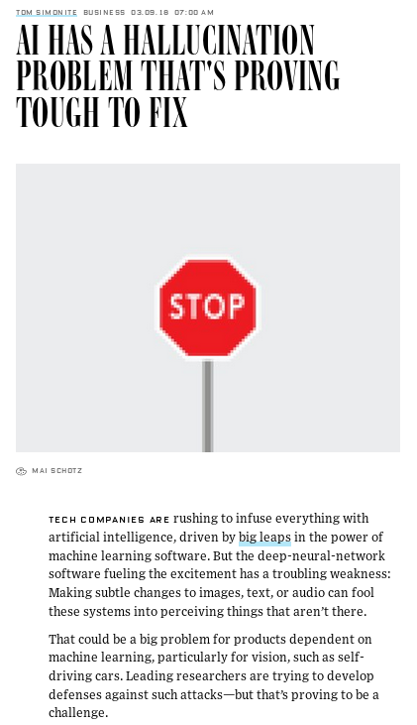

Motivation

Slide 4
Outline
Introduction
Outline
Generating Adversarial Examples
Defense Strategies
Ensemble Method
Results
Conclusions
Future Works

Slide 5
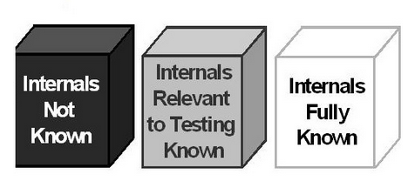



Generating Adversarial Examples
Types of adversarial attacks
Targeted - an attack intentionally trying to perturb images to a specific class when misclassified.
Non-targeted - an attack to simply have images misclassified.
White Box - an attack that uses the specifications of a model to generate adversarial examples.
Black Box - Only inputs and outputs are known to generate an adversarial example.
Notes:
Describe different types of Adversarial ex (Targeted, non-targeted & Black Box vs White Box)

Slide 6
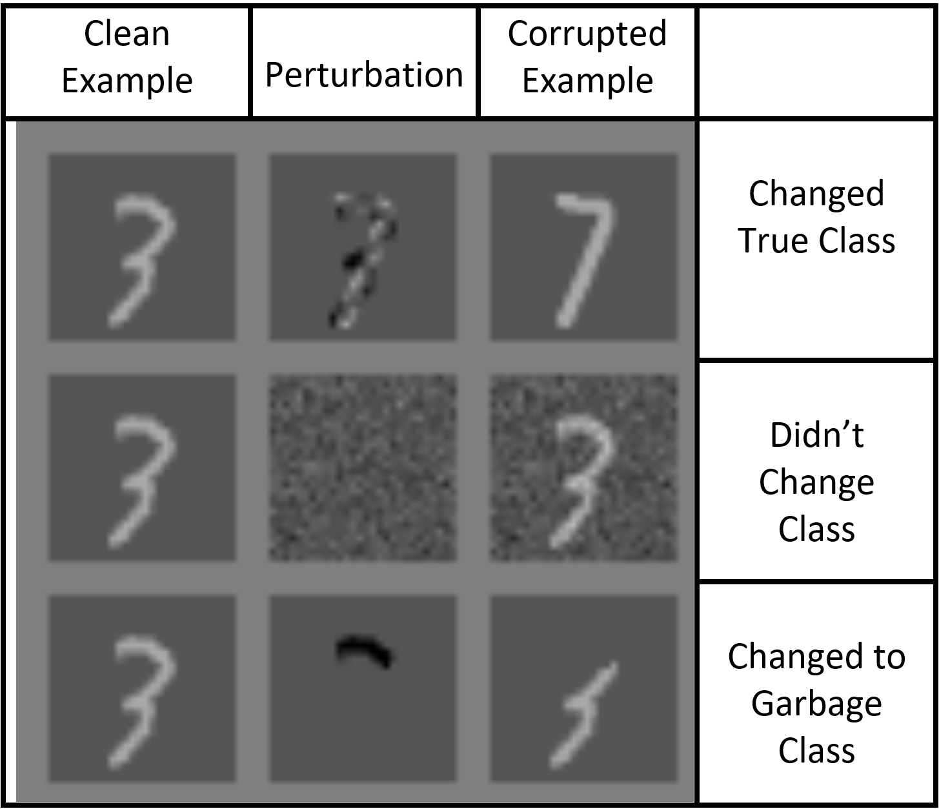
Adversarial Attacks
Fast Gradient Sign Method (FGSM)
x_{FGSM} = x + 𝜀 ∙ sign[𝛻_{x} J(𝛩, x, y)]
Basic Iterative Method (BIM)
x₀ = x,
x_{i} = clip_{x,𝜀} (x_{i-1} + α sign[𝛻_{i-1} J(𝛩, x_{i-1}, y)])
x_{BIM} = x_{n}
Limited Memory BFGS (L-BFGS)
minimize c ∙ ||x - x’||²₂
such that x’ ∈ [0,1]^{n}
Notes:
Adversarial
- 0.3 for fgsm
BIM
Iteration = 8, alpha = 0.03 for bim
L-BFGS
Constrained optimization problem
Binary Search steps =3, iterations =10 for lbfgs

Slide 7
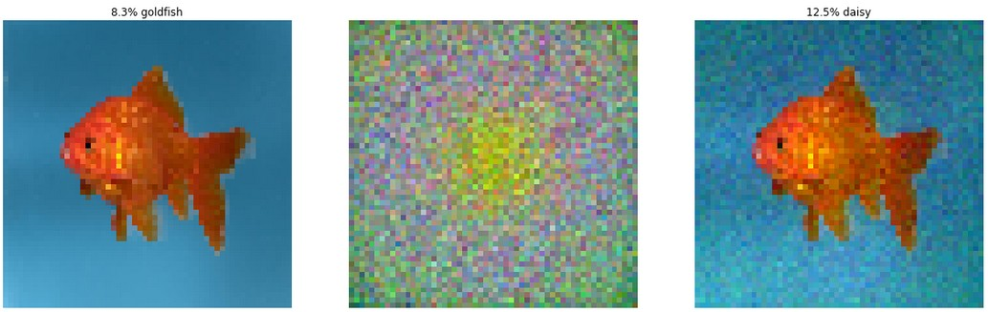
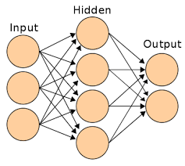
Defense Strategies: Adversarial Training
Model trains on an image from the training set
Generates adversarial example
Trains on correctly labeled adversarial example
Repeat
Goldfish
Goldfish
Goldfish
“Daisy”

Slide 8

Defense Strategies: Bagging + Noise
Given training data T with m data points
Draw m samples (w/ replacement) from T
Ensemble
2’
1’
2’
2’
3’
3’
2’
1
1’
1’
1’
3
3’
2
1’
Bagging
1’
1’
3’
2’
1’
Original Training Set
Noise
Training Set W/ Noise
2’
2’
3’
1’

Slide 9
Defense Strategies: Ensemble
Set of classifiers
Majority vote of classifiers
Input
Image
Input Image
Majority Vote Classifier
Output
Input Image

Slide 10


Implementation
Datasets:
MNIST, CIFAR-10 & Tiny-ImageNet
MNIST Model, CIFAR-10 Model, Inception V3
Majority Vote Ensemble
Generating Adversarial Attacks:
Cleverhans - A Python library using TensorFlow
Notes:
Insert an image of the Inception model architecture

Slide 11
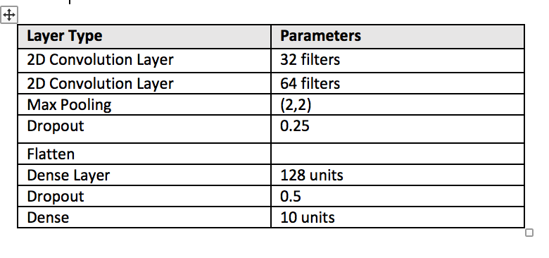
Ensemble Implementation
MNIST Architecture:
Notes:
Same architecture, with bagging plus noise and majority voting

Slide 12
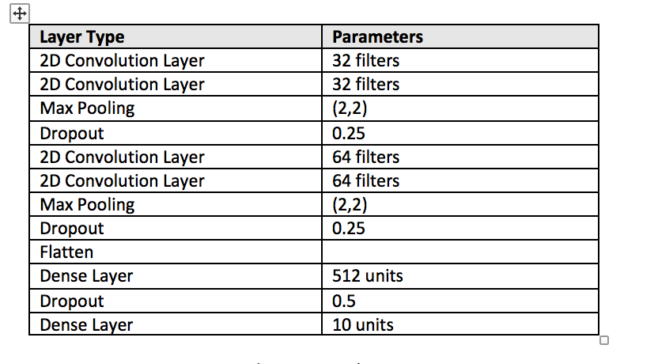
Implementation Continued
CIFAR-10 Architecture:

Slide 13
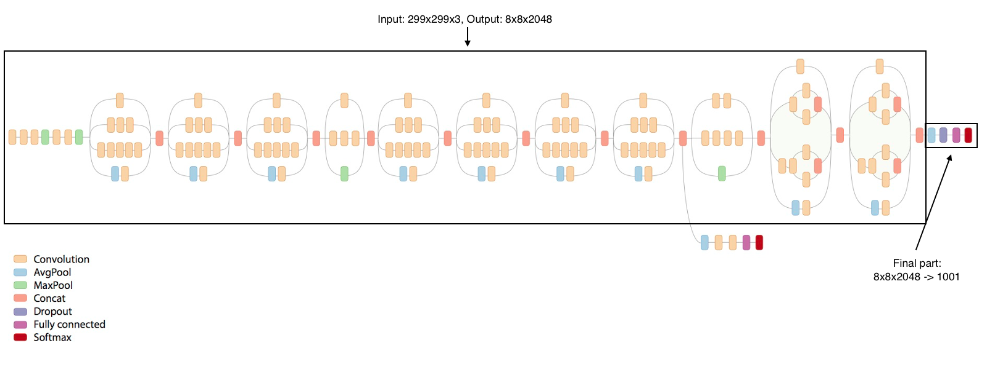
Implementation Continued
Inception Architecture
Notes:
http://silverpond.com.au/2016/10/24/pedestrian-detection-using-tensorflow-and-inception.html

Slide 14
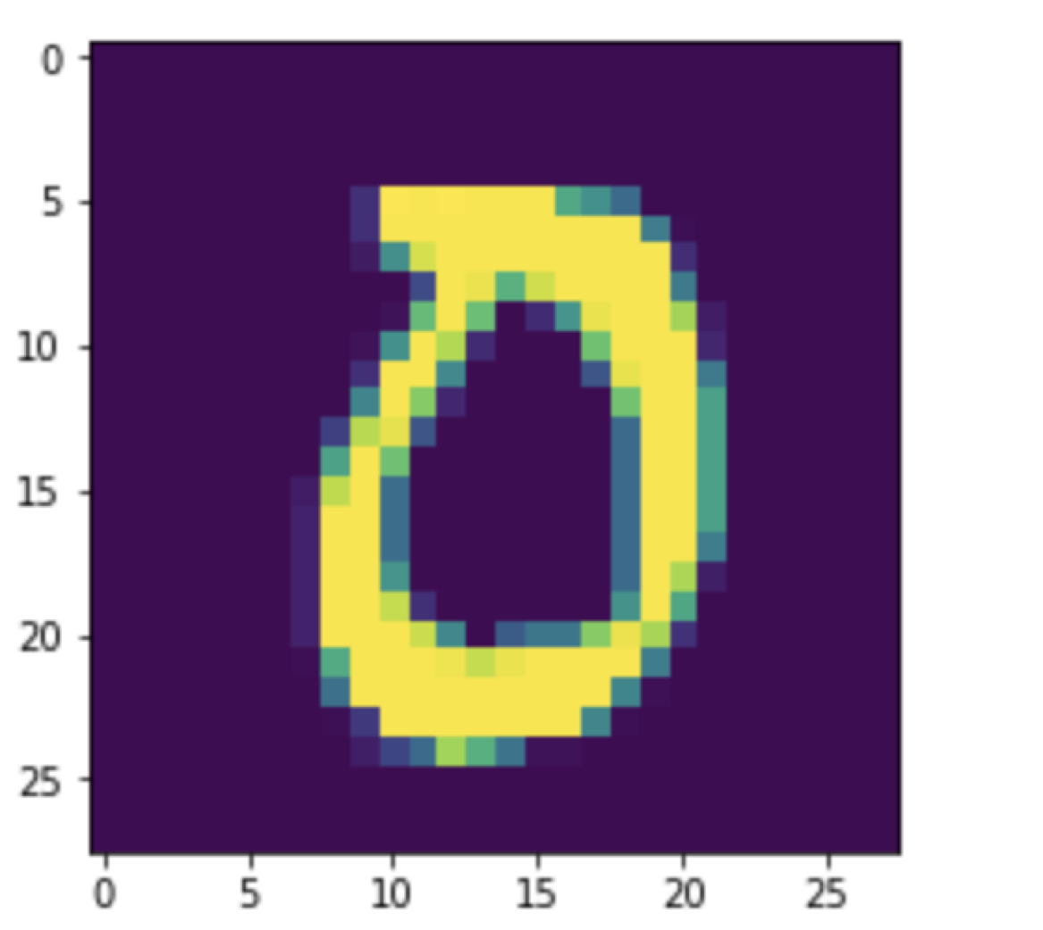
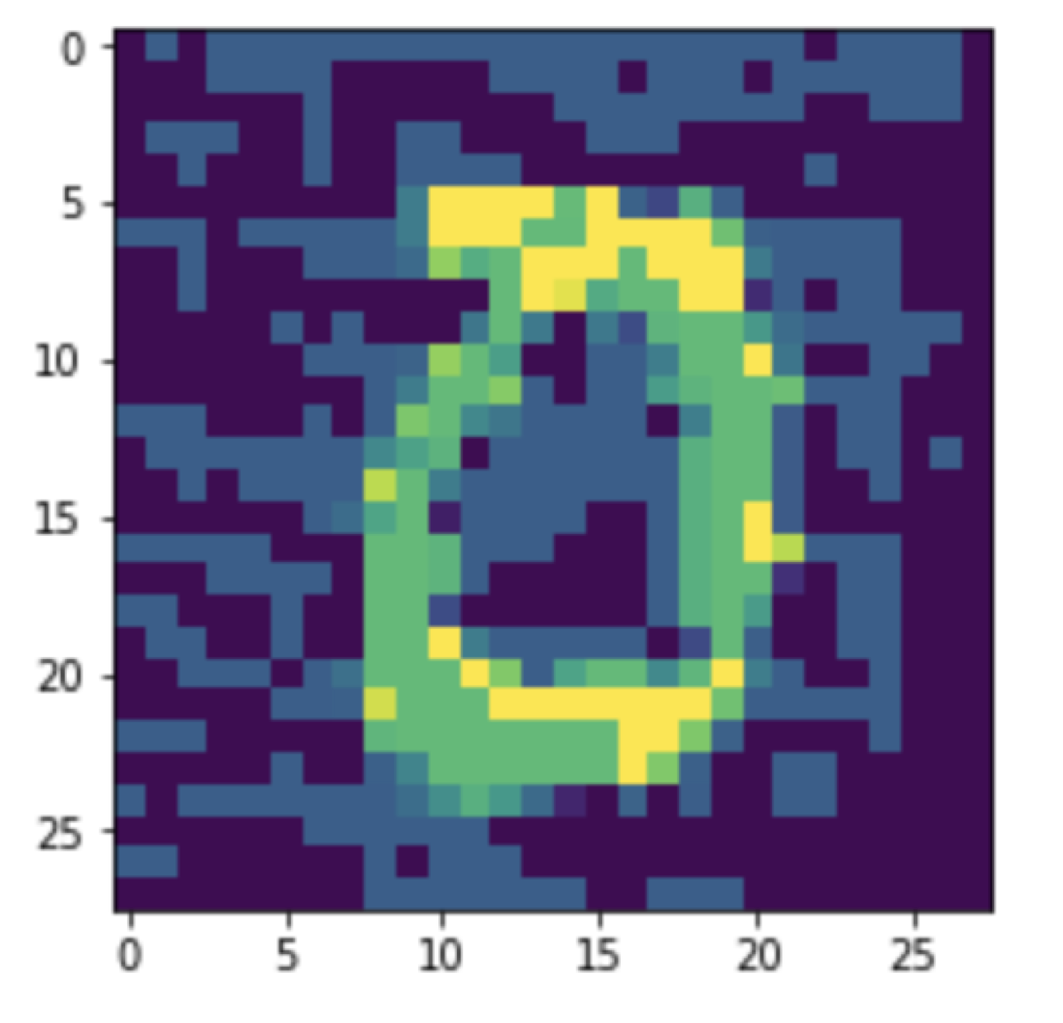
Results
Original Image, Prediction:0
FGSM, Prediction: 3

Slide 15
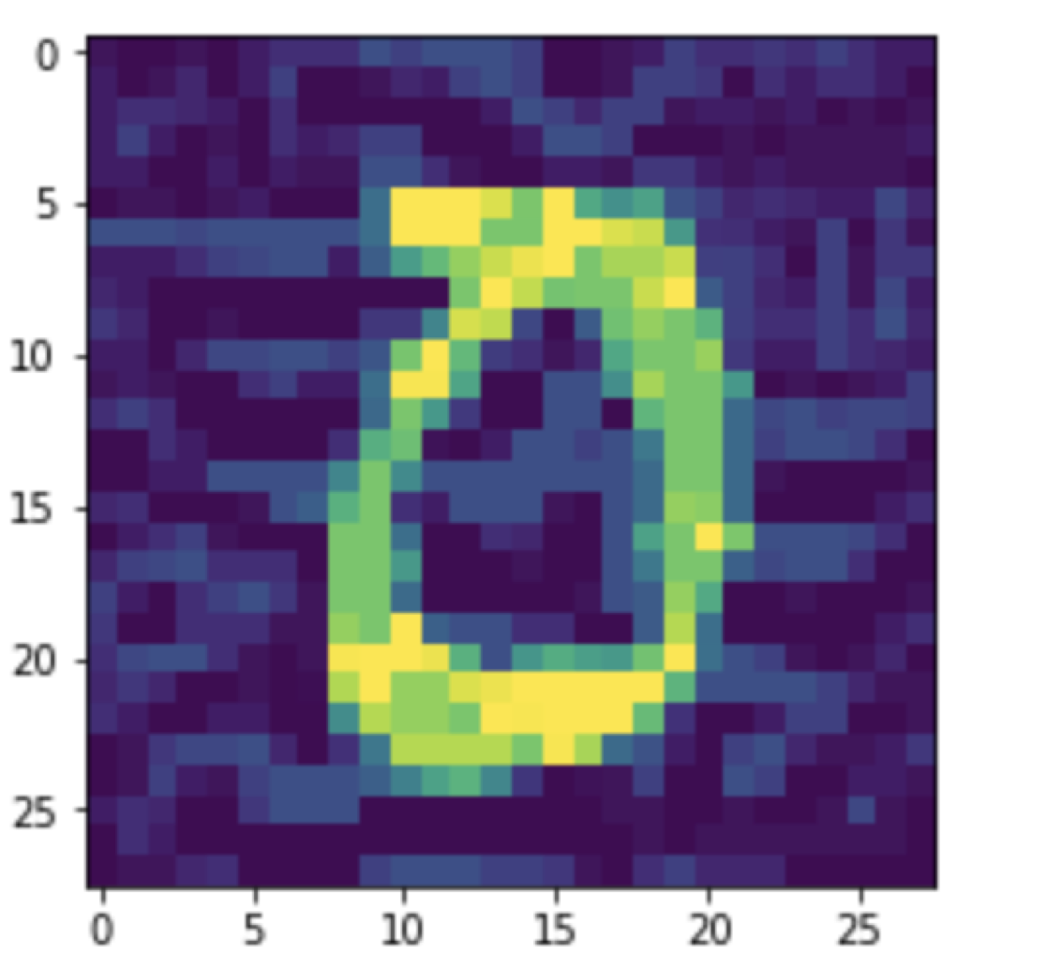
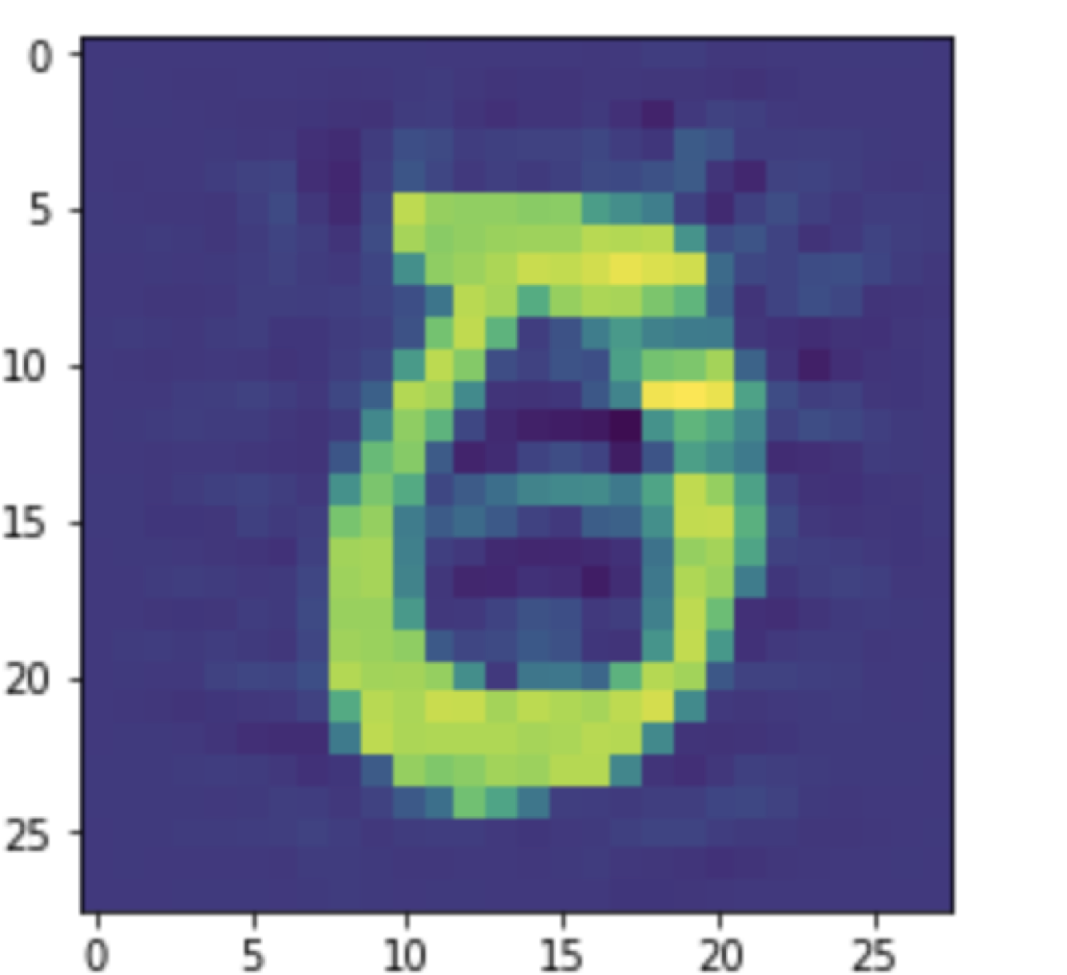
Results Continued
BIM, Prediction: 2
LBFGS, Target:6, Prediction:6

Slide 16

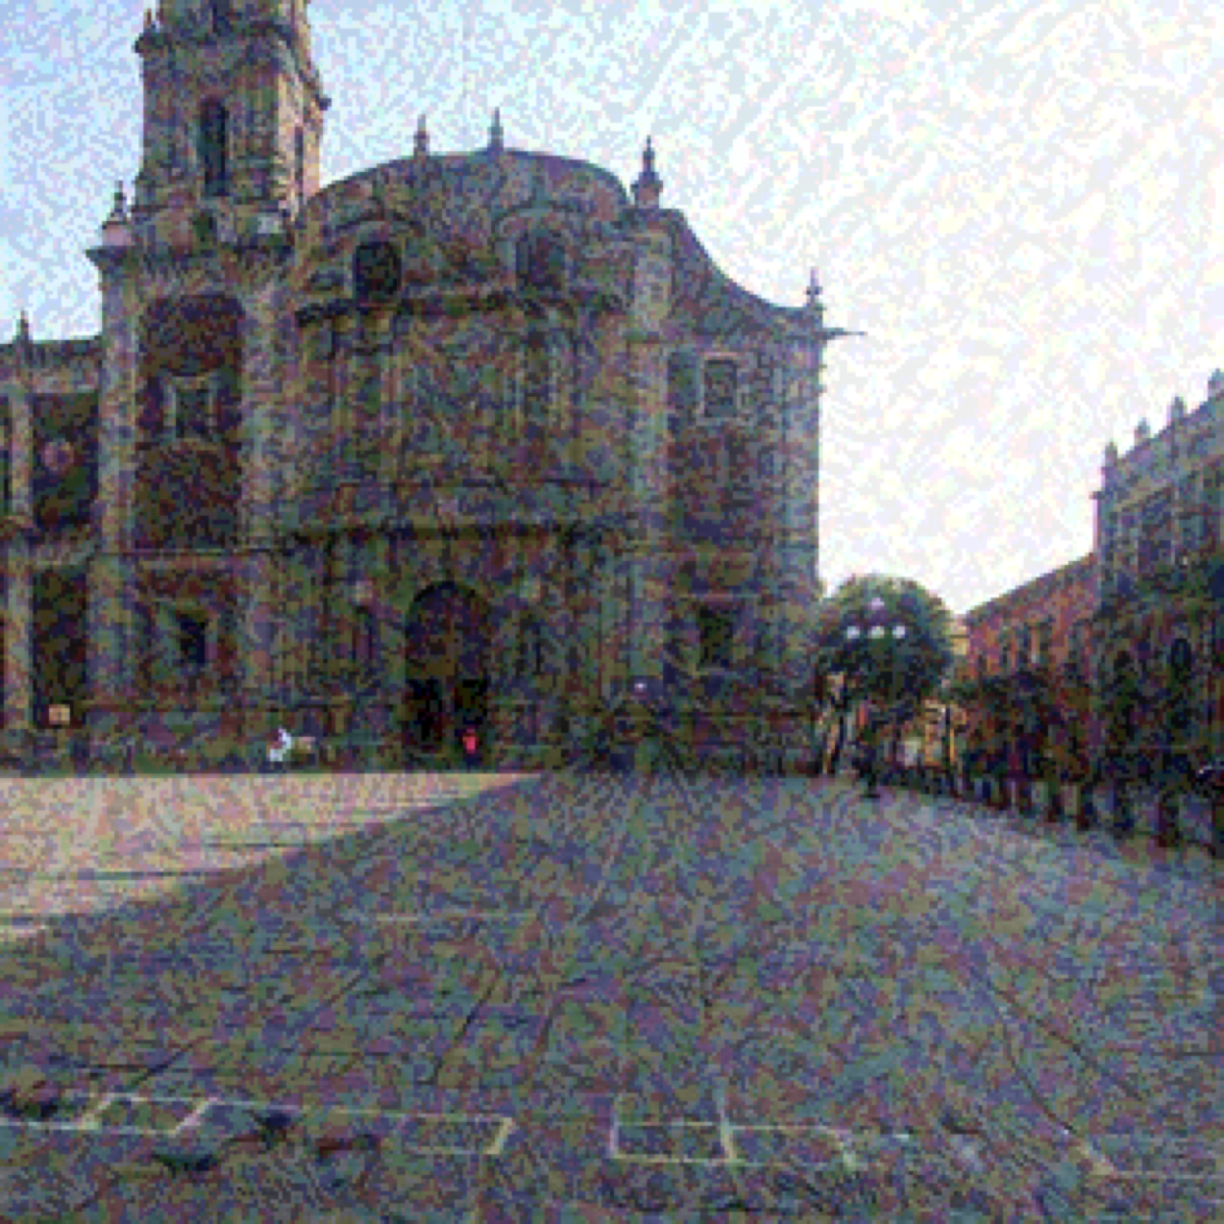
Results Continued
Original Image, Prediction:Building
FGSM, Prediction:Bookcase

Slide 17
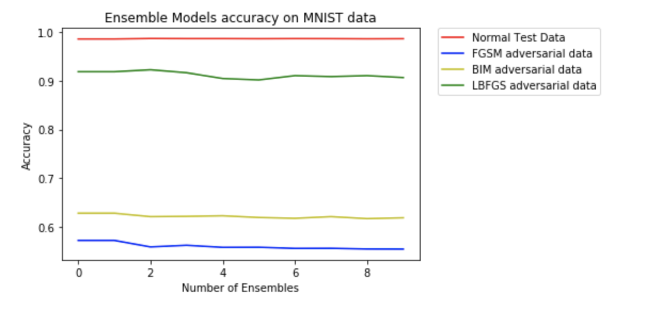
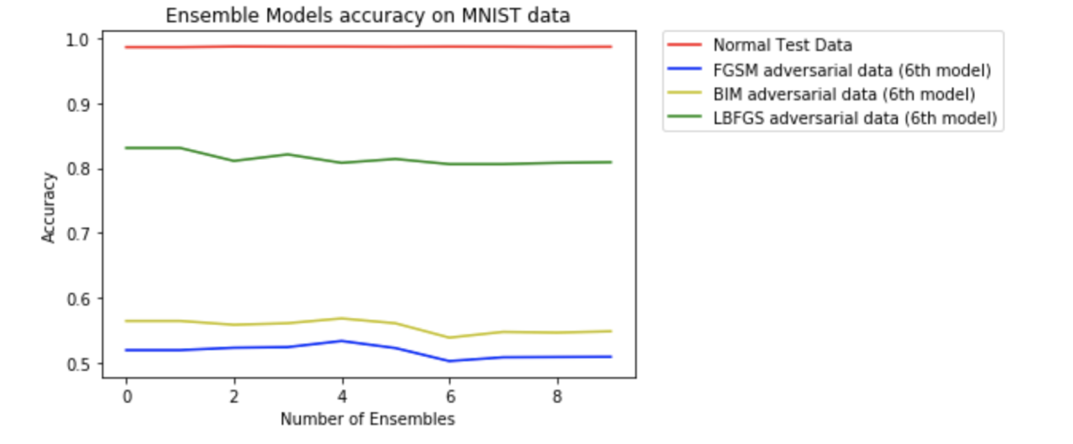
MNIST Results
Ensemble models accuracy
Ensemble models accuracy on adversarial images of 6th model.

Slide 18
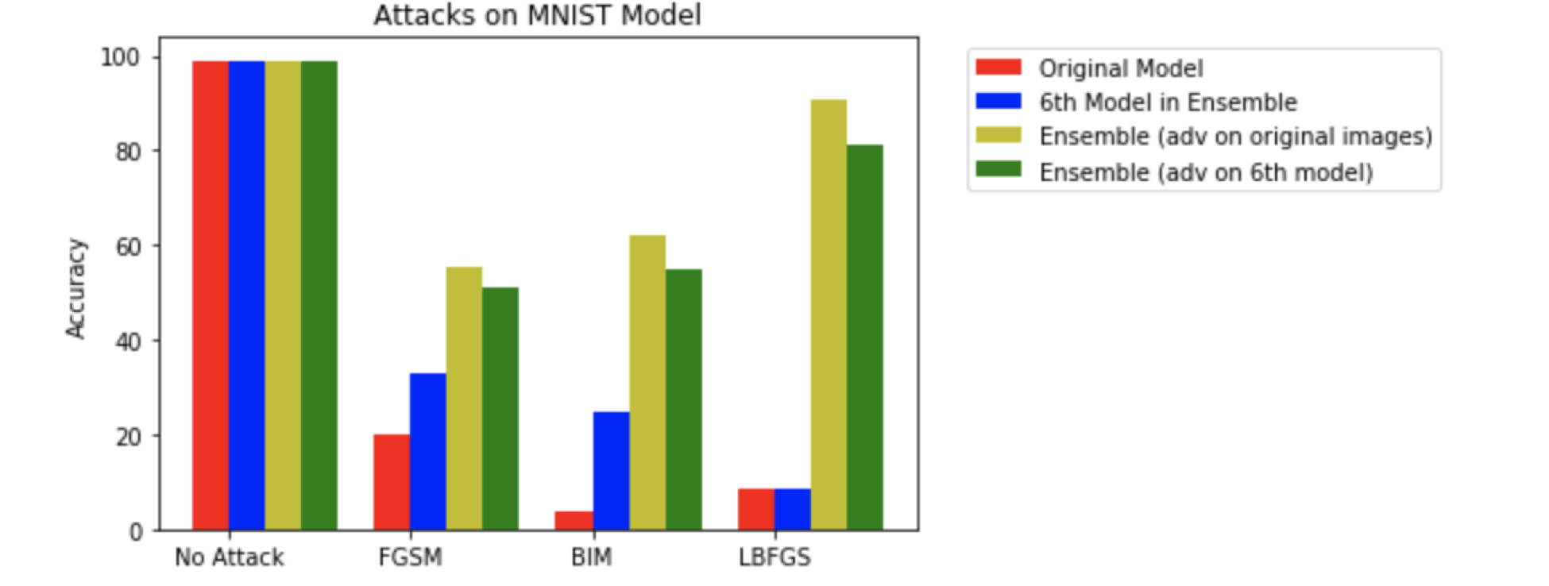
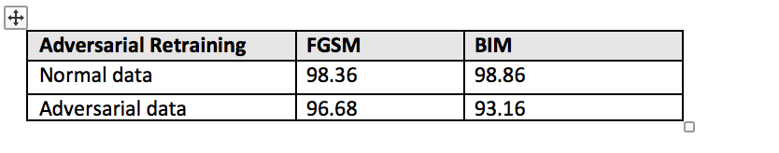
MNIST Results Continued
Accuracy on different attacks
Accuracy after adversarial training

Slide 19
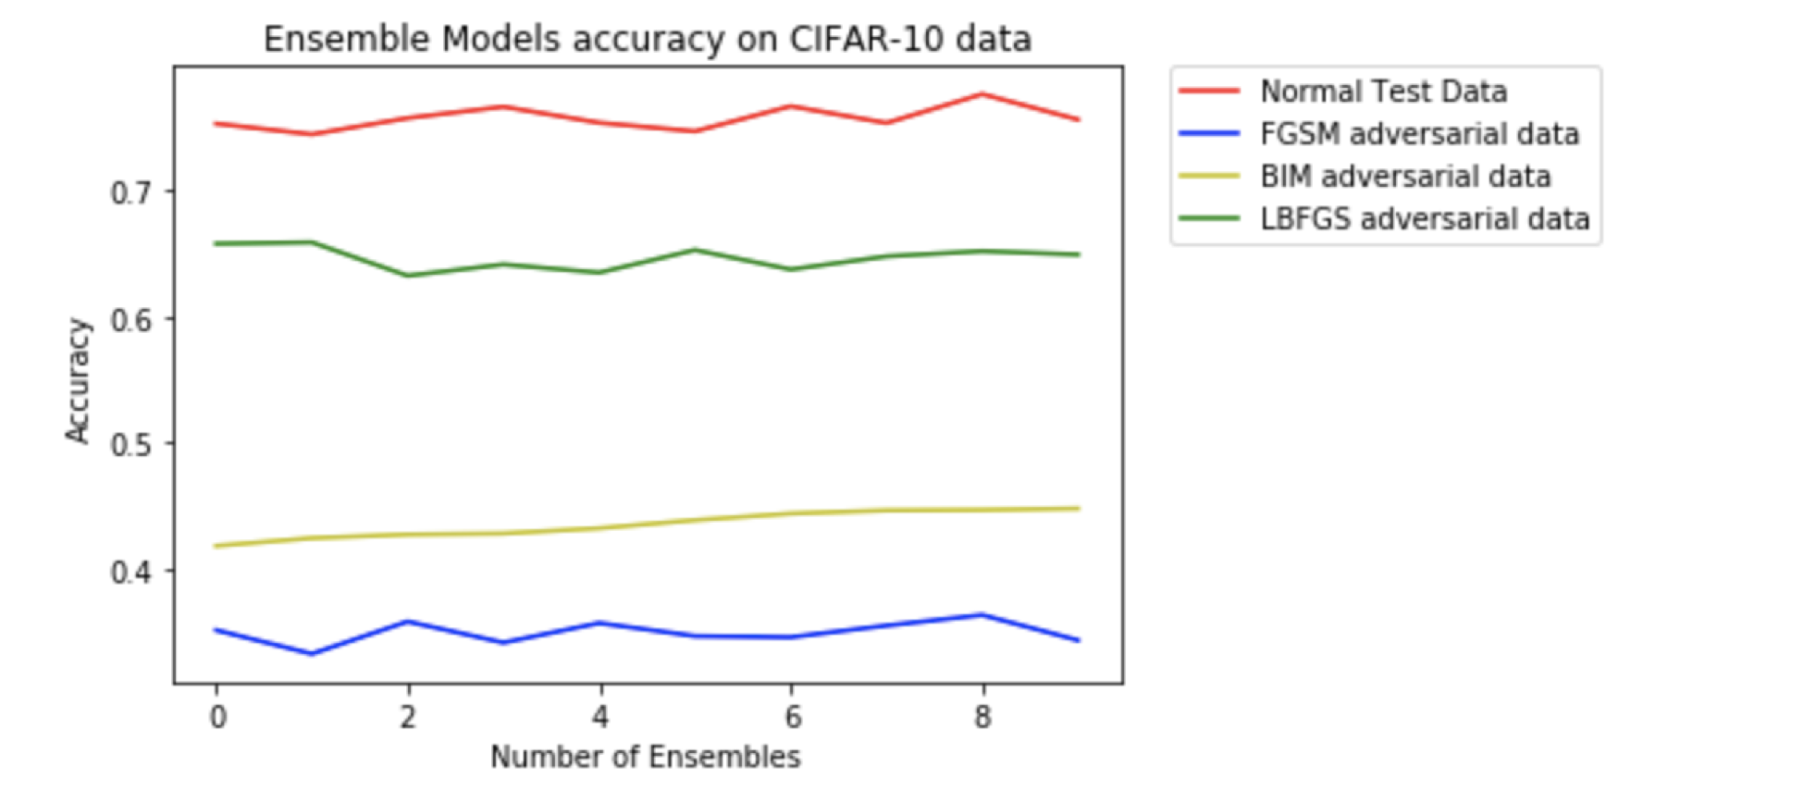
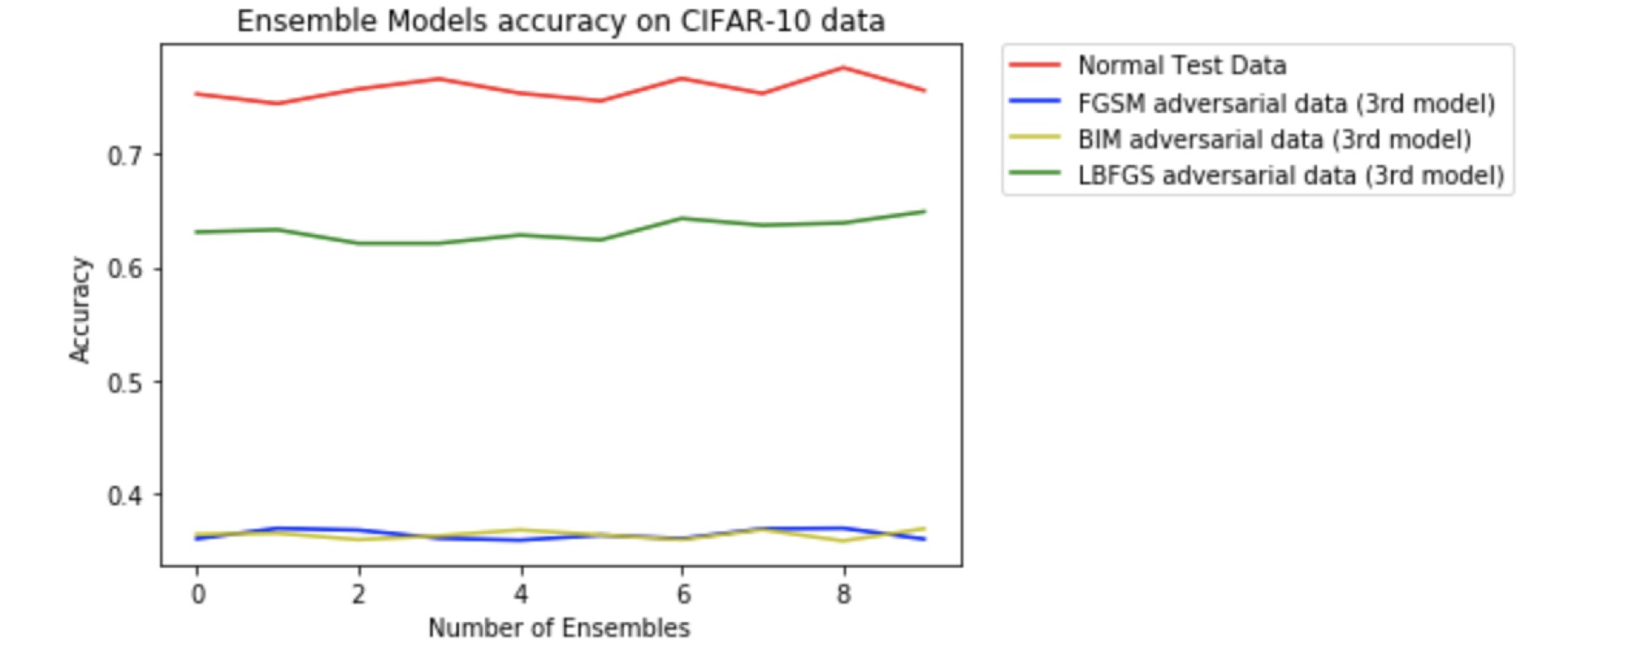
CIFAR-10 Results
Ensemble models Accuracy
Ensemble models Accuracy
Ensemble models accuracy
Ensemble models accuracy on adversarial images of 3rd model.

Slide 20
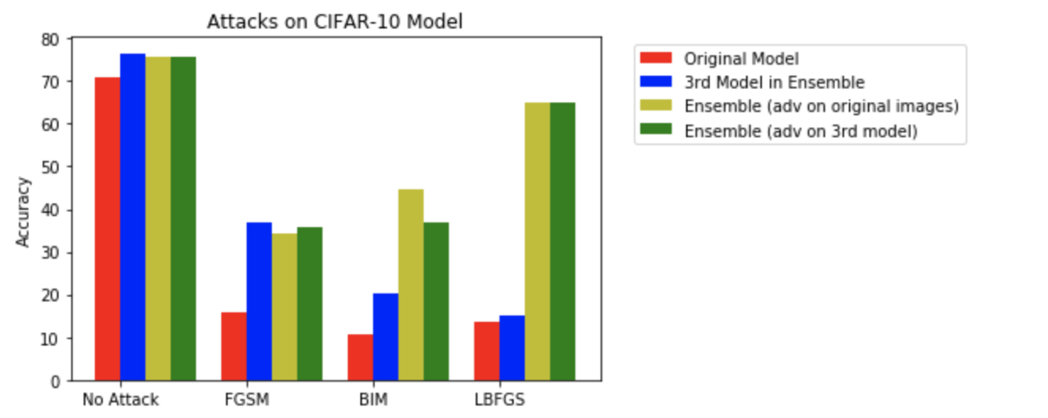
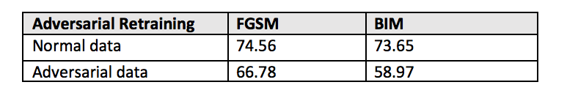
CIFAR-10 Results Continued
Accuracy on different attacks
Accuracy after adversarial training

Slide 21
Conclusions
DNN’s are highly vulnerable to adversarial examples
Defending against adversarial examples is challenging
Adversarial training makes the network more robust and is better compared to Ensemble methods.
Ensemble methods like bagging + noise can provide
Increased accuracies on test data
Increase classifier robustness on these attacks

Slide 22
Future Work
Successfully train the Inception model on HCC.
Test on a wide variety of models and datasets.
Combine Adversarial training with an ensemble.
Test our network on different attacks.
Apply Boosting on the ensemble.
Test the L-BFGS attack on different target values.

Slide 23
References
[1] I. J. Goodfellow, J. Shlens, and C. Szegedy. Explaining and harnessing adversarial examples. arXiv preprint arXiv:1412.6572, Dec. 2014.
[2] T. Strauss, M. Hanselmann, A. Junginger, H. Ulmer, Ensemble Methods as a Defense to Adversarial Perturbations Against Deep Neural Networks, arXiv preprint arXiv:1709.03423, 2017.

Slide 24

Thanks for your attention!
P.Chakraborti,B.Moore
Department Physics
University of Nebraska-Lincoln
CSCE 496/896 Deep Learning

